Slide 1

IPv6 animation
Fundamentos de Redes
Mestrado Integrado em Engenharia de Computadores e Telemática
DETI-UA, 2016/2017

Slide 2

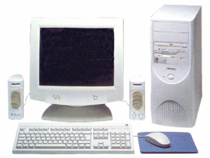

Stateless auto-configuration
MAC address is 00:0E:0C:31:C8:1F
EUI-64 address is 20E:0CFF:FE31:C81F
Internet
2. Do a Duplicate Address Detection
And the DNS Server Address ?!
1. Create the link local address
3. Send Router Solicitation
4. Create global address
6. Set Default Router
5. Do a DAD
FE80::20E:0CFF:FE31:C81F
Router Solicitation
Dest. FF02::2
2001:690:1:1::
20E:0CFF:FE31:C81F
FE80::20F:23FF:FEf0:551A
*/0
FF02::2 (All routers)
Router Advertisement
2001:690:1:1
FE80::20F:23FF:FEF0:551A
4-<number>
Notes:
Fundamentos de Redes II

